Slide 1
Social Network analysis of IMDB data
Group members :
Mopidevi Gnana Sundar (2019286)
Sama Prabhas Vardhan Reddy (2019141)
Jayant Kamesh (2019073)
Vallamalla Srividya (2019170)
Instructor
Dr. Avinash Chandra Pandey

Slide 2
Introduction
The goal of this project was to take the dataset of top 1000 IMDB movies and apply several social network analysis techniques on it.
The nodes of this network are movies, actors and genres. The edges denote movie relations, actor co-occurrence, and genre relationship.
We try to analyze the movies, actors, and genres through graphs.
By analyzing top 1000 movies and observing the graphs we try to find what are the most successful genres and actors.

Slide 3
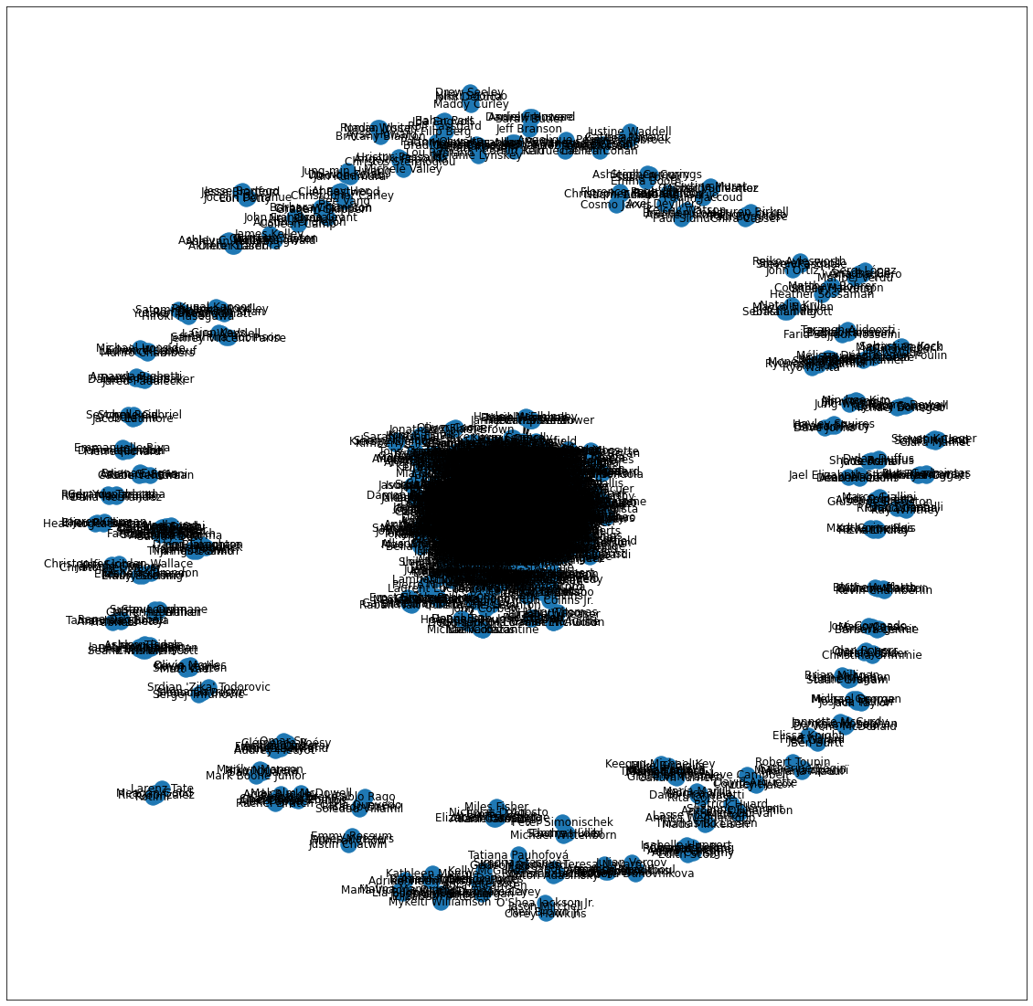
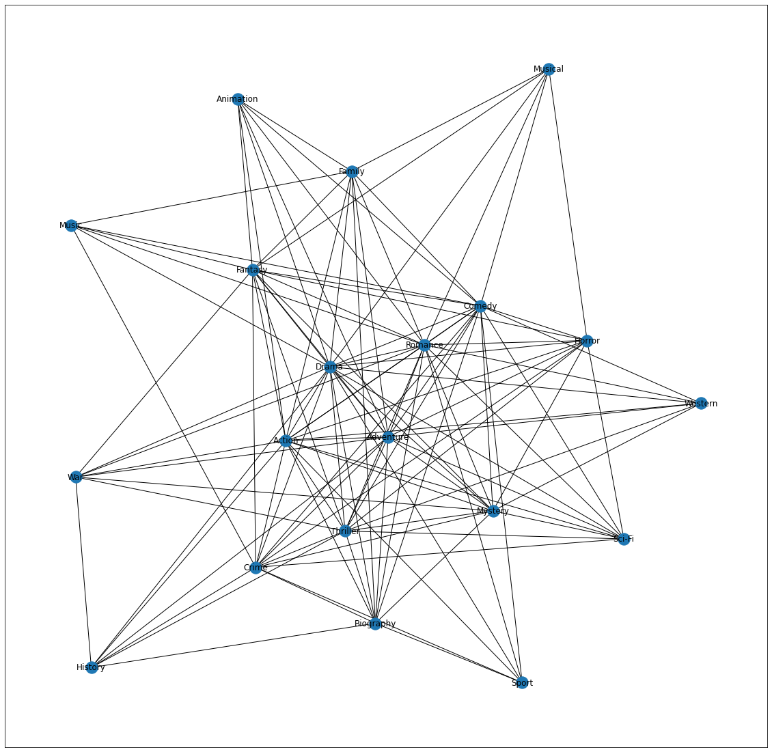
First, we created a network of all actors as nodes and their connections as edges.
Second network has genres as nodes which identifies the genre with more prominence in top rated IMDB films.
These networks help us calculating various centralities and also predicting future possible links.

Slide 4
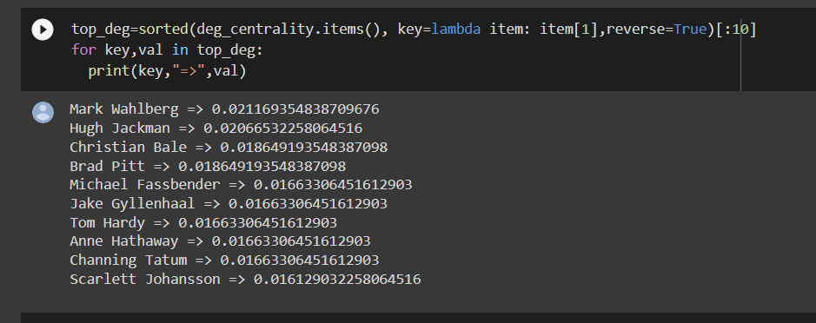
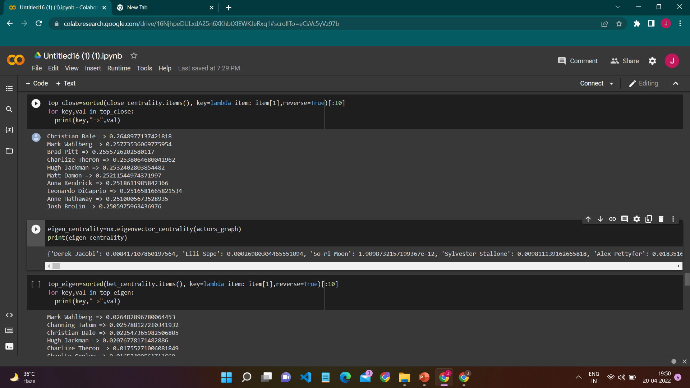
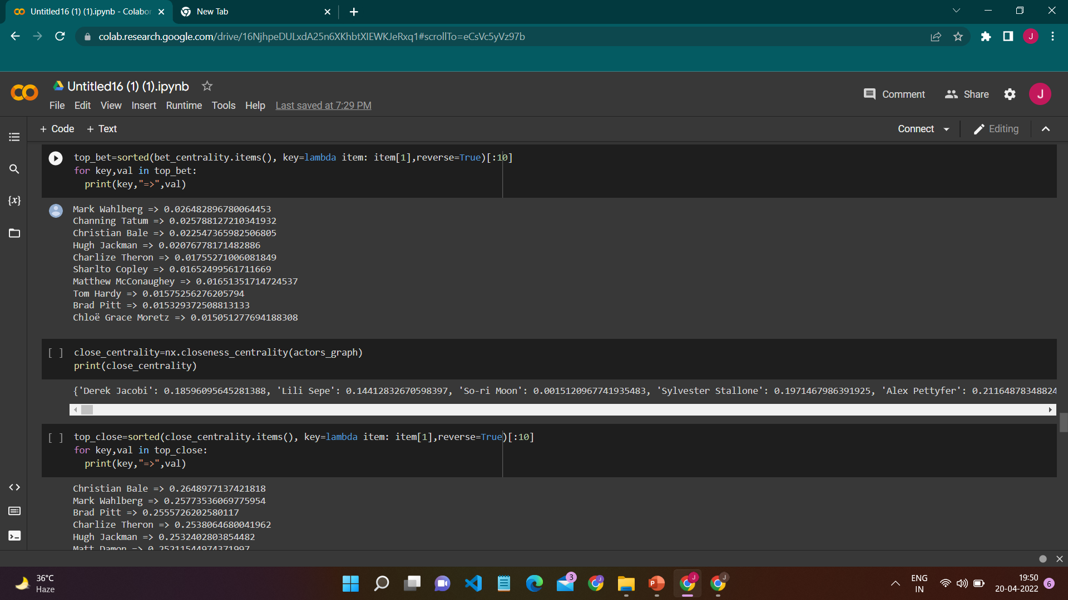
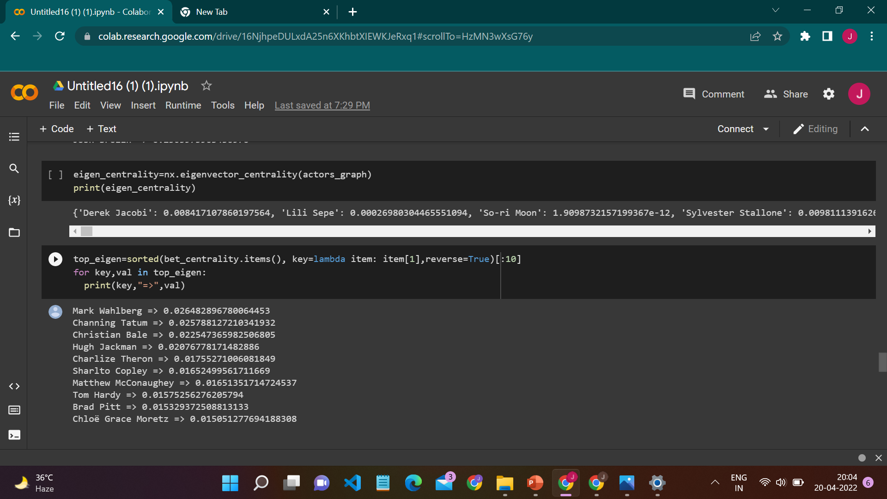
Different Centrality Measures

Slide 5
As shown in the previous slide, we found centrality for actors using four methods and printed top 10 actors.
Mark Wahlberg had the highest centrality in 3 out of 4 methods which signifies that he is the most sought out actor and has a better movie success ratio.
LINK PREDICTION
we’ve sorted out the ten most prominent actors based on their degrees.
We also predicted the chance of them collaborating in a movie using JAC,PAC, AAC, and RAC.
Christian Bale, Michael Fassbender and Christian Bale, Jake Gyllenhaal have high chances of working together in the near future.

Slide 6
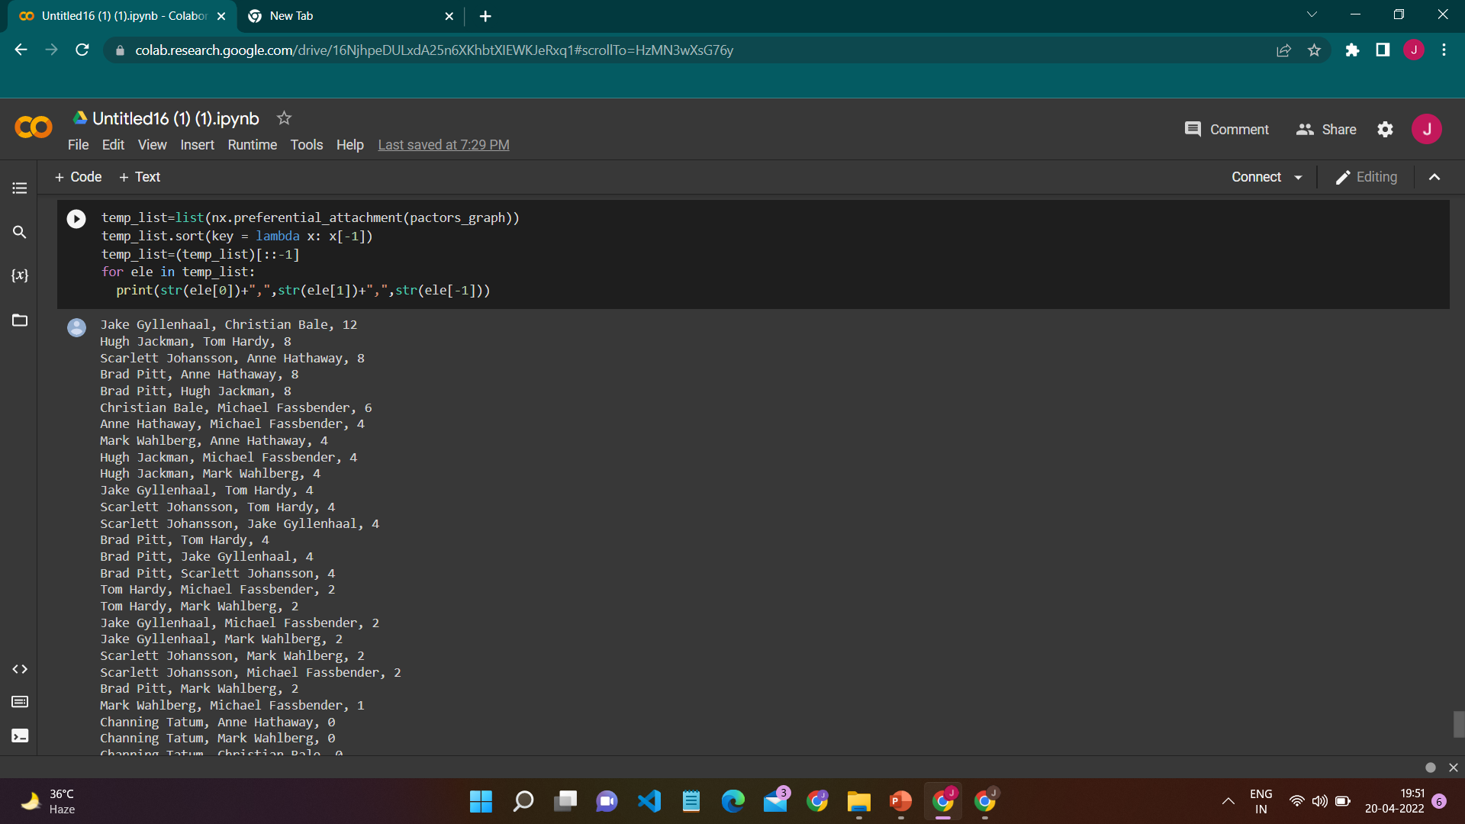
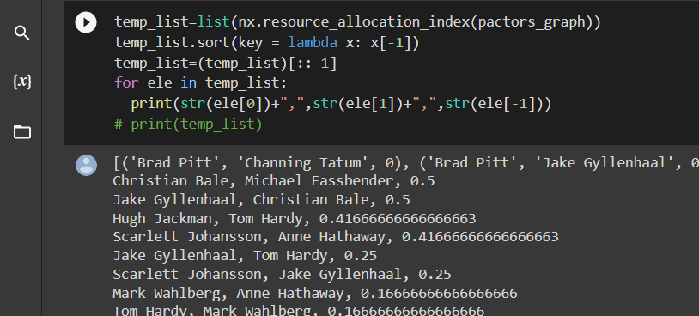
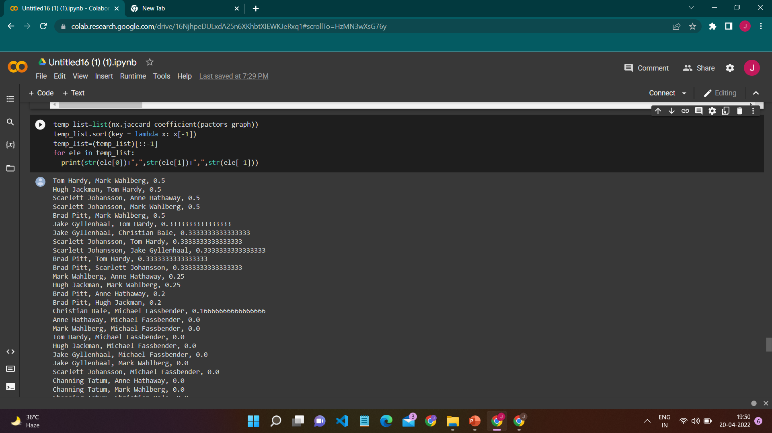
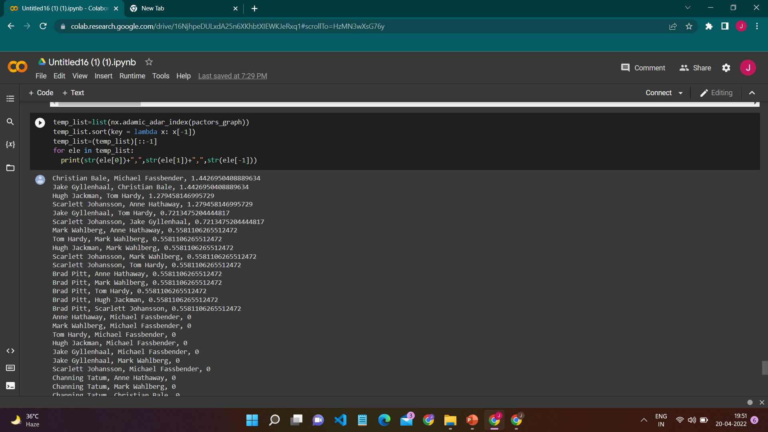
Link Prediction using Different Methods

Slide 7
Conclusion
From the analysis, we found which actors are dominant by finding the centralities of each actor treating them as nodes in a network. Them having high centrality signifies their importance for a movie to be top rated.
By using link prediction, we found the chance of the top ten actors working together for a movie. We can say that the collaboration of these two actors will be a successful film.

Slide 8
Thank You

